Slide 1
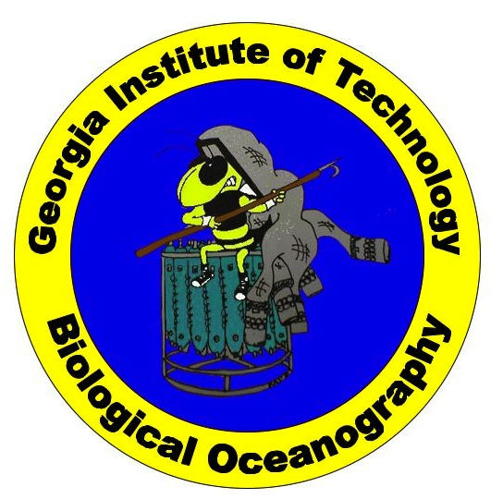
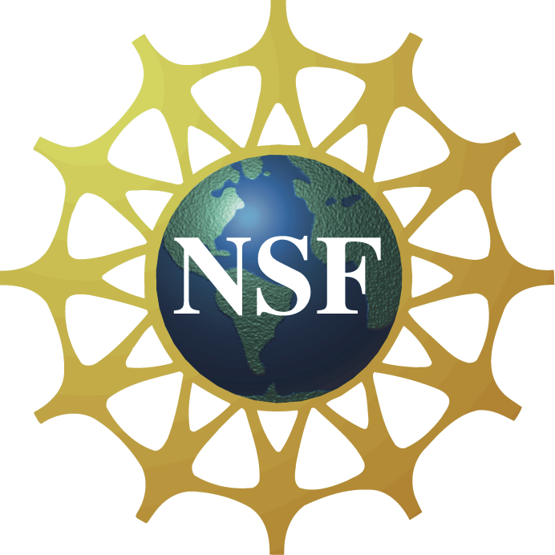
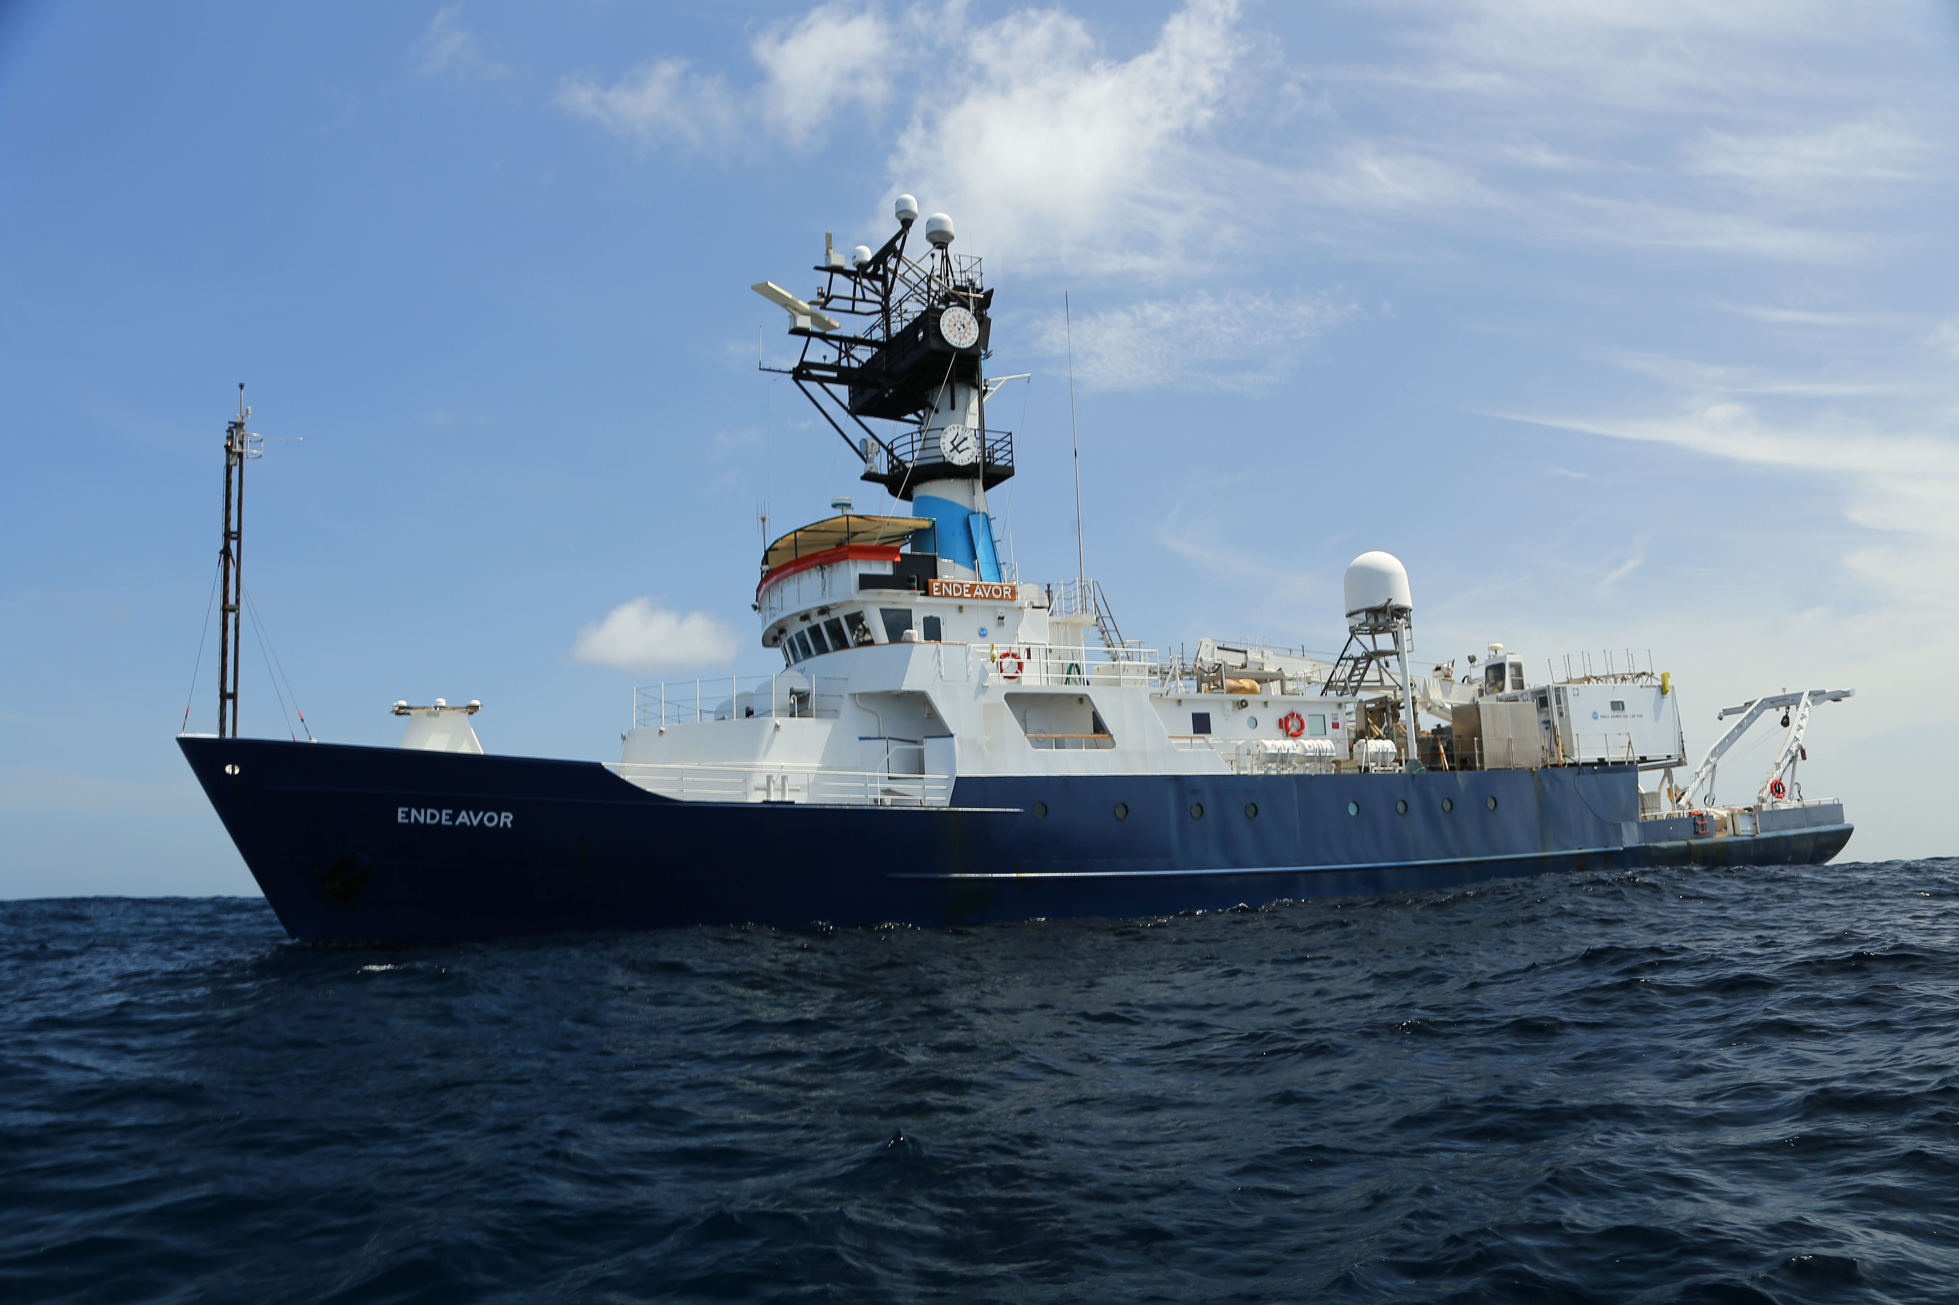
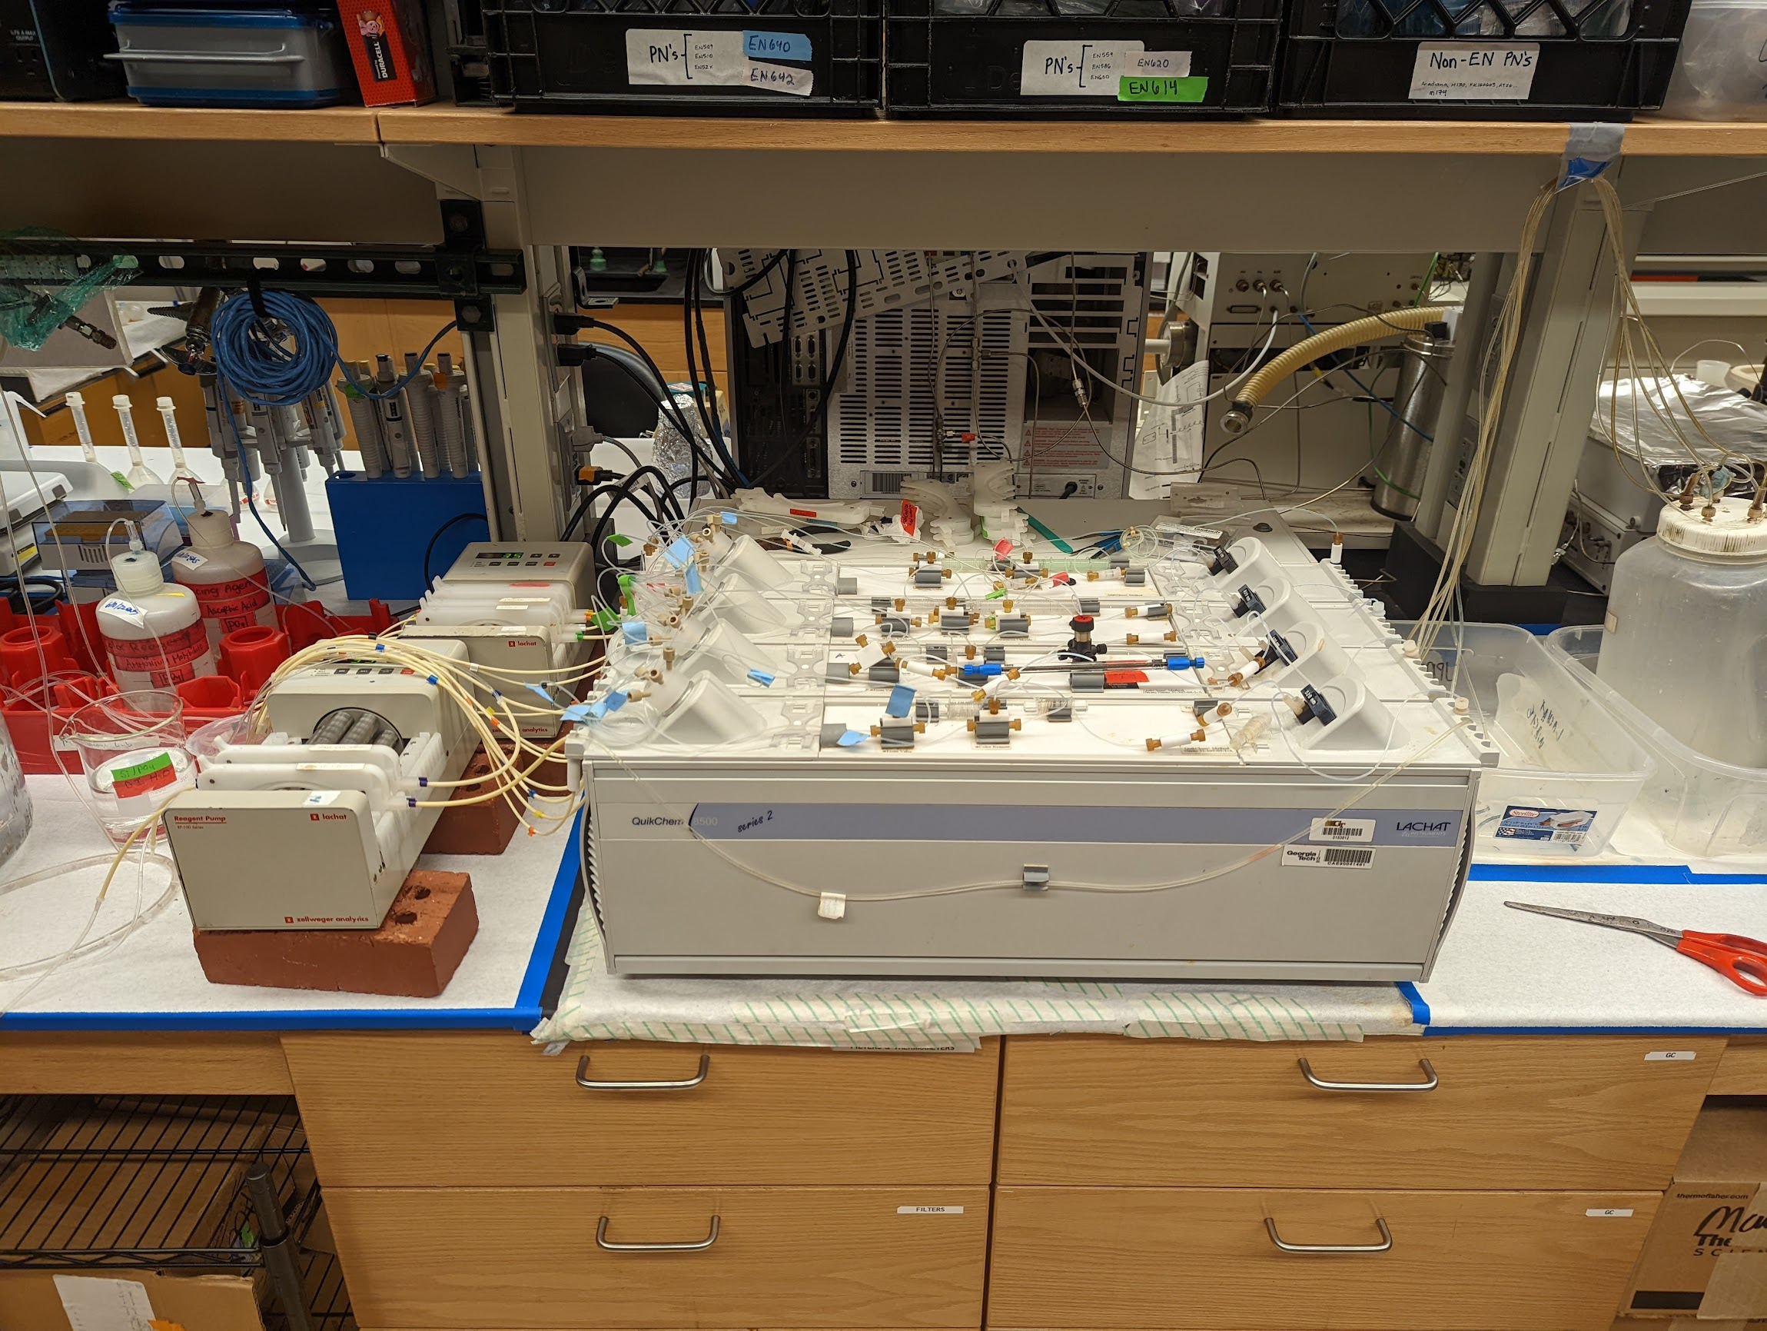
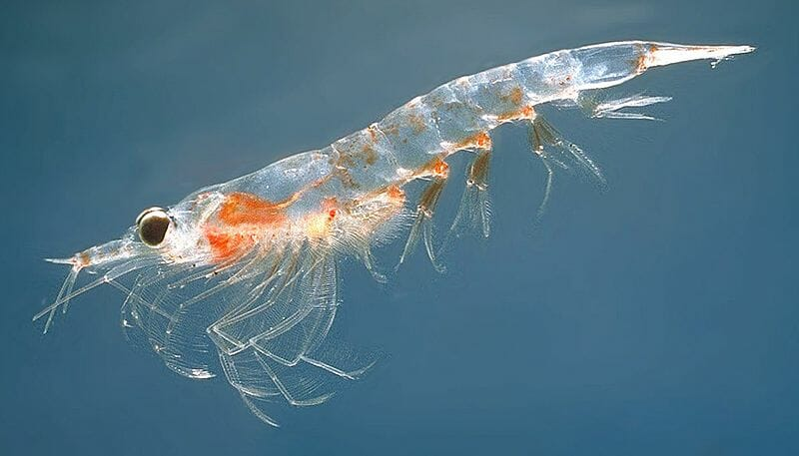
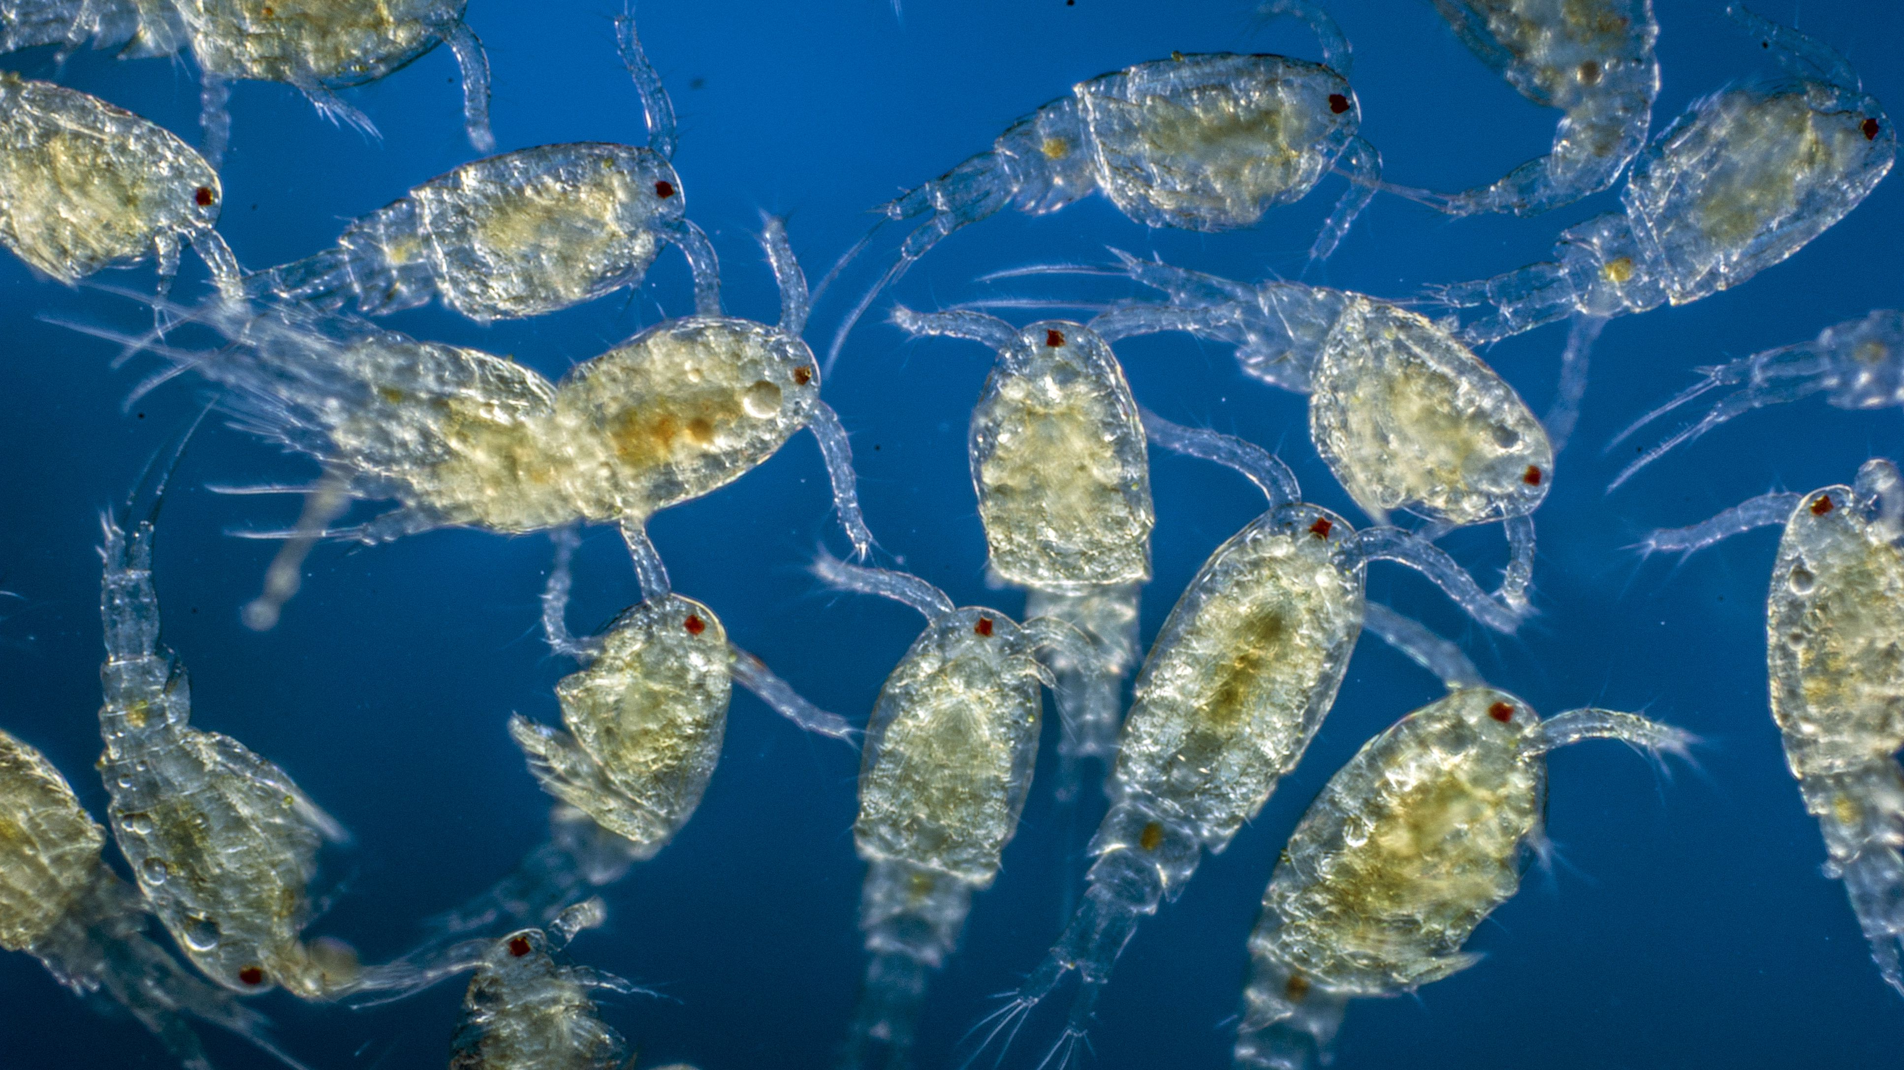
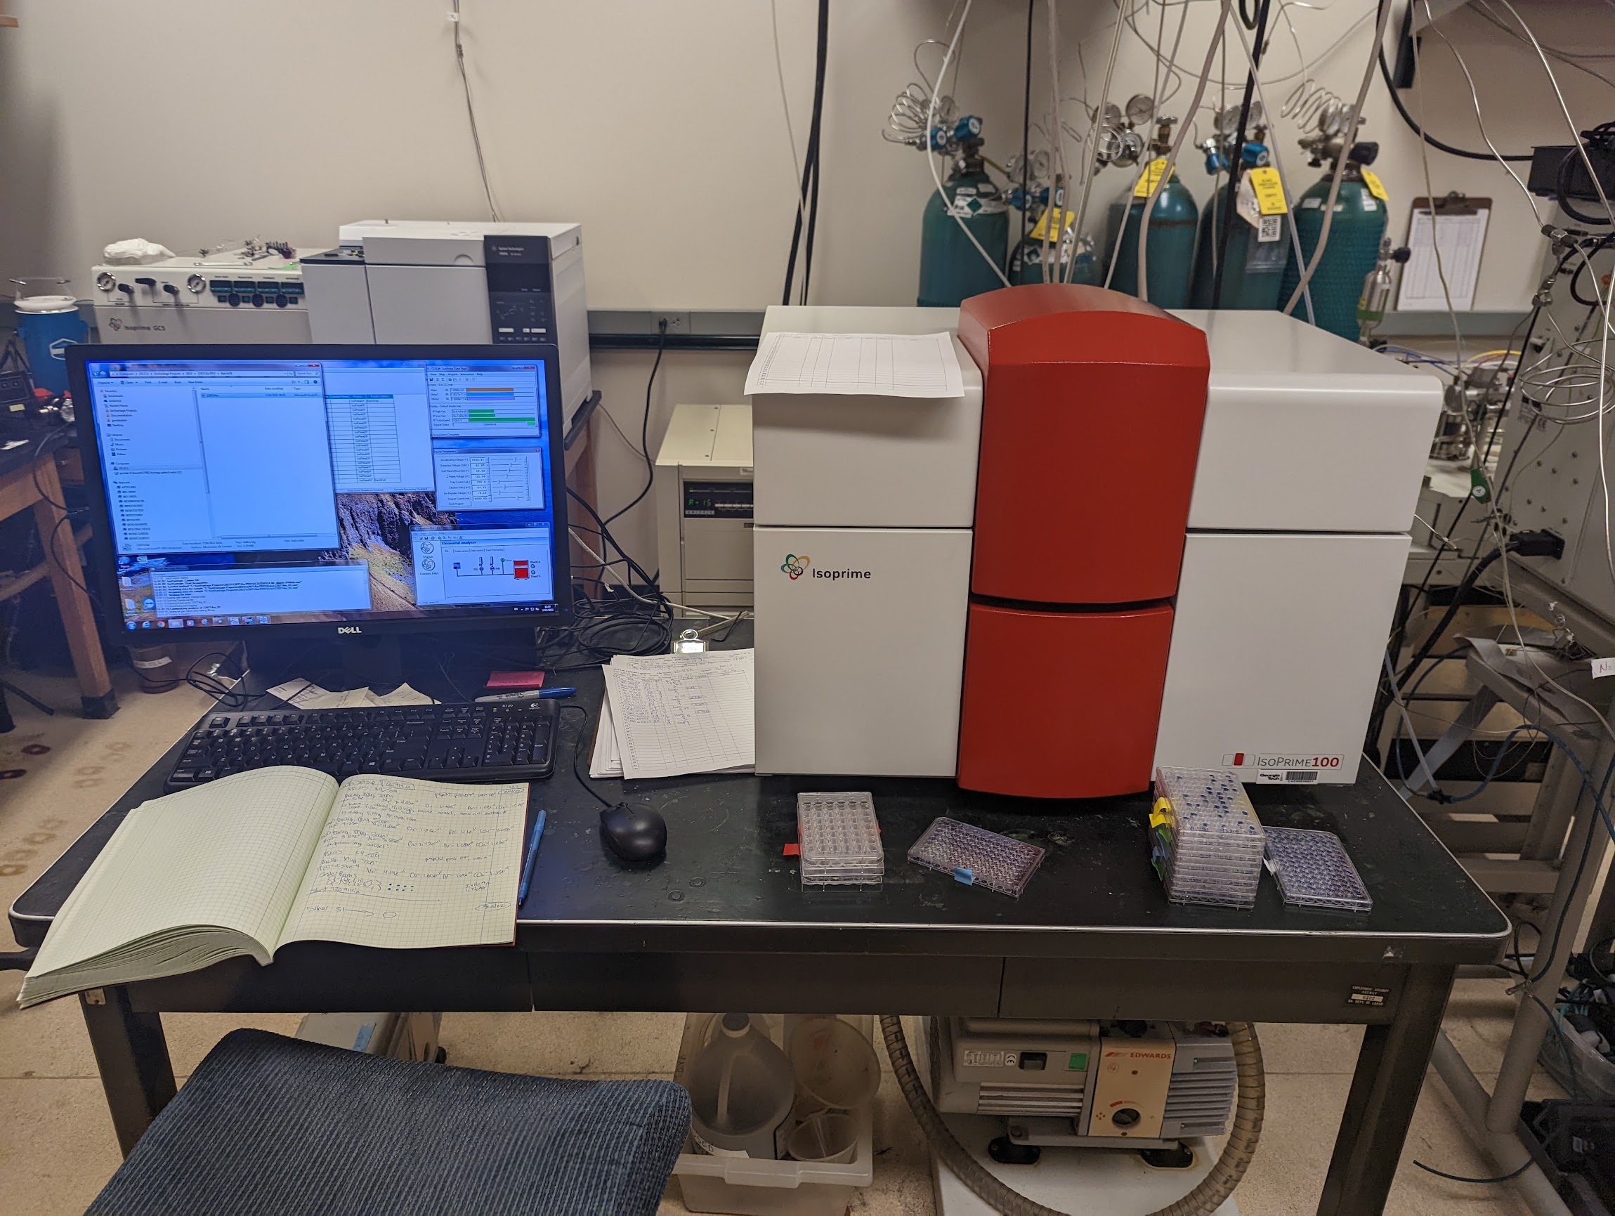
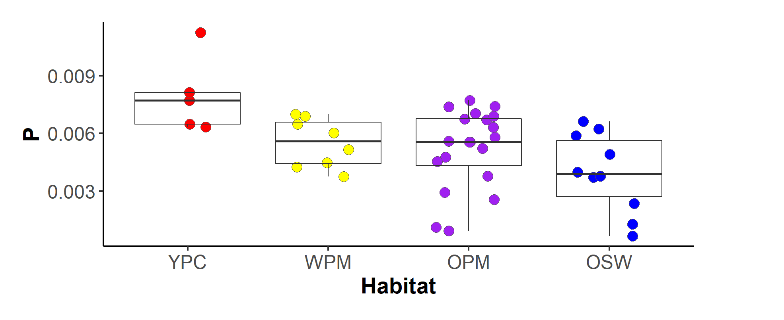
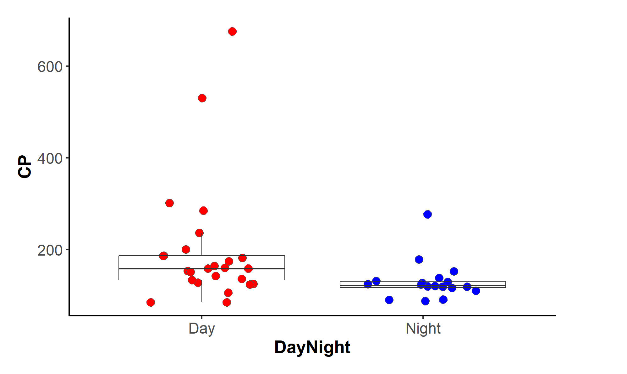
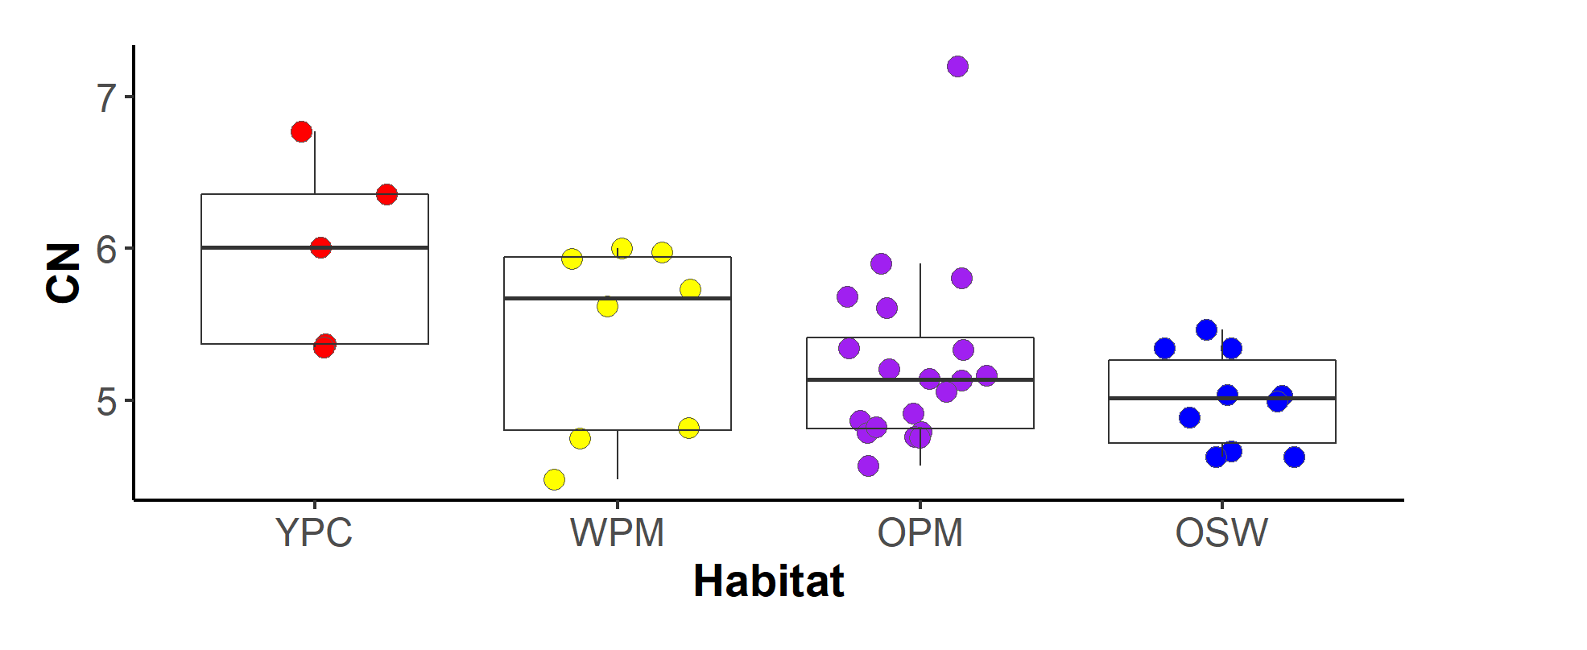
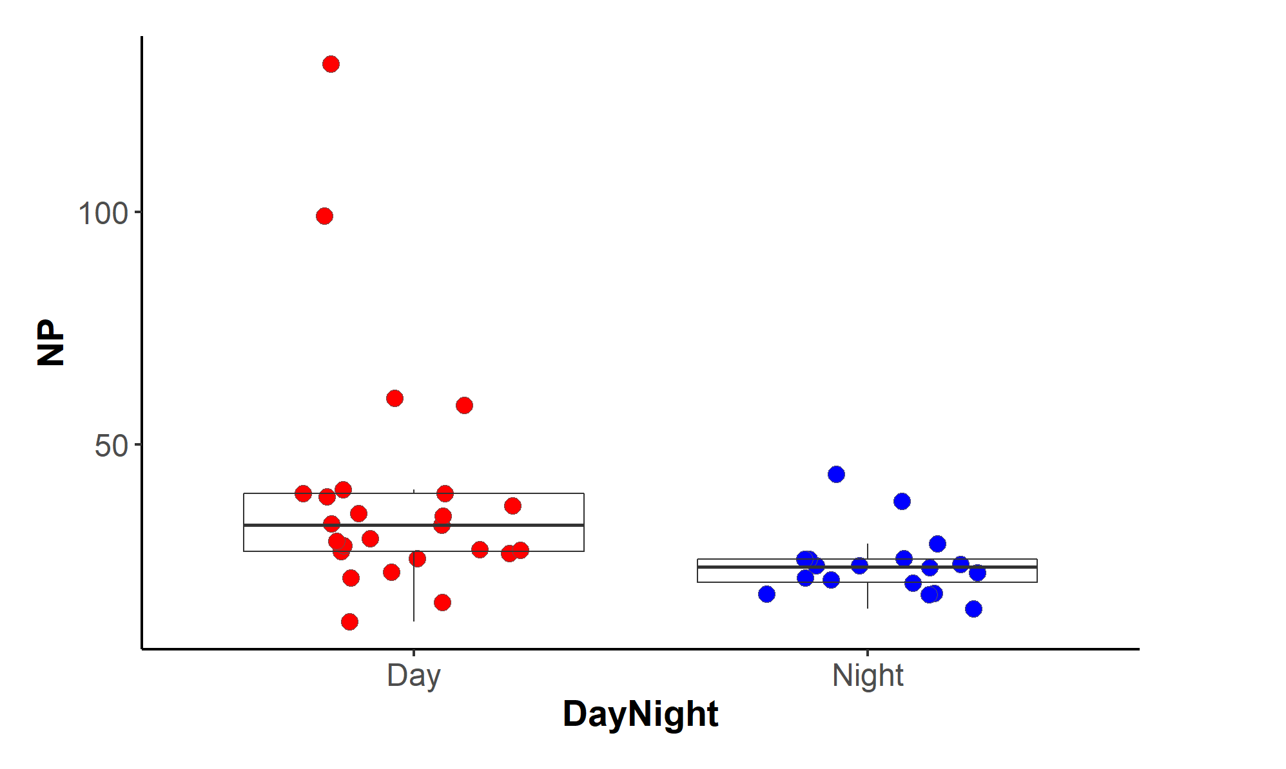
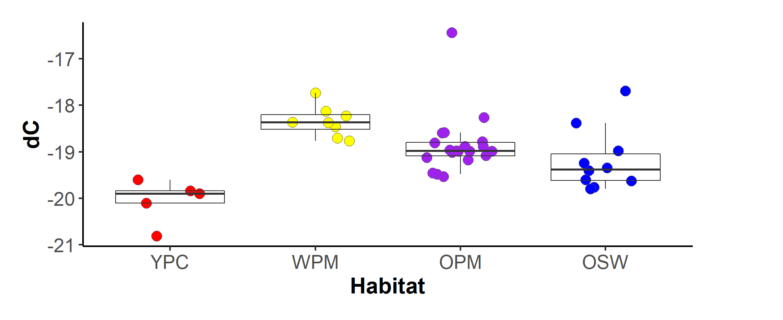
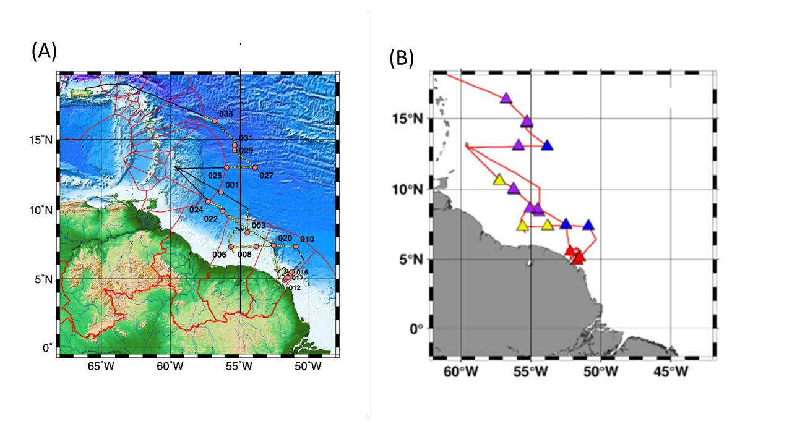
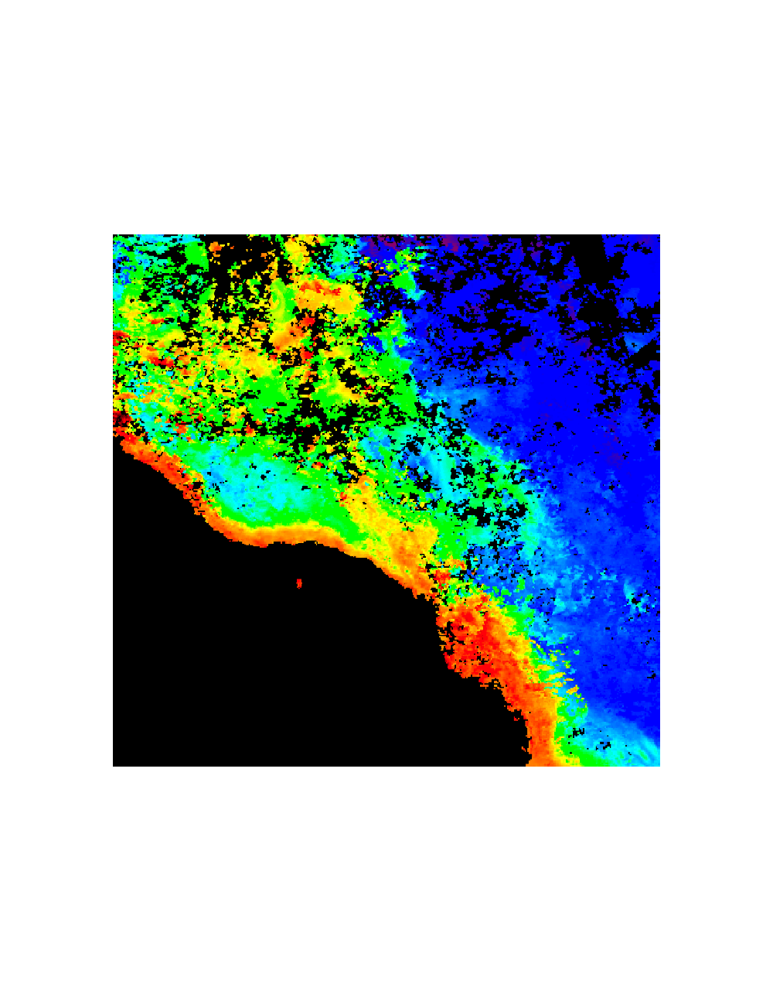
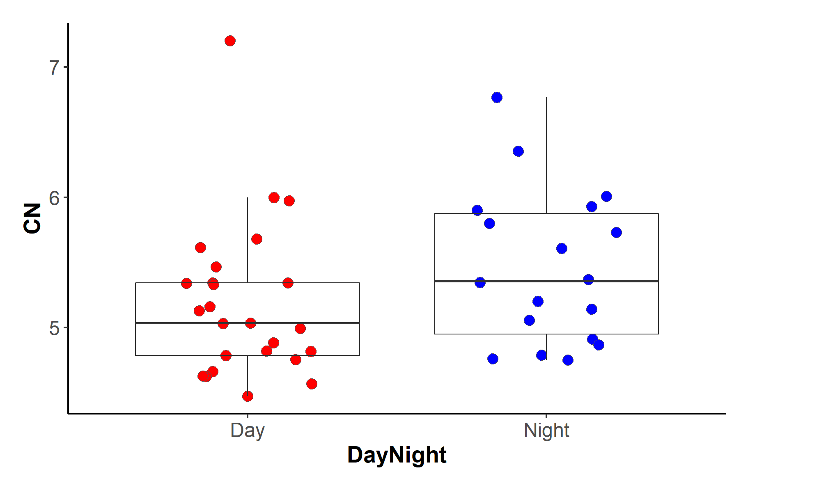
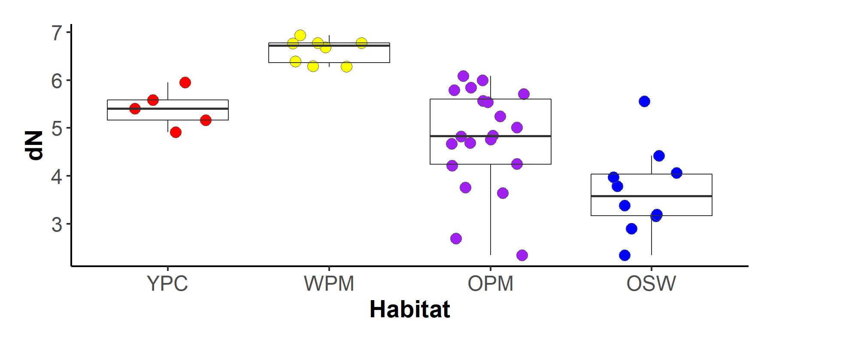
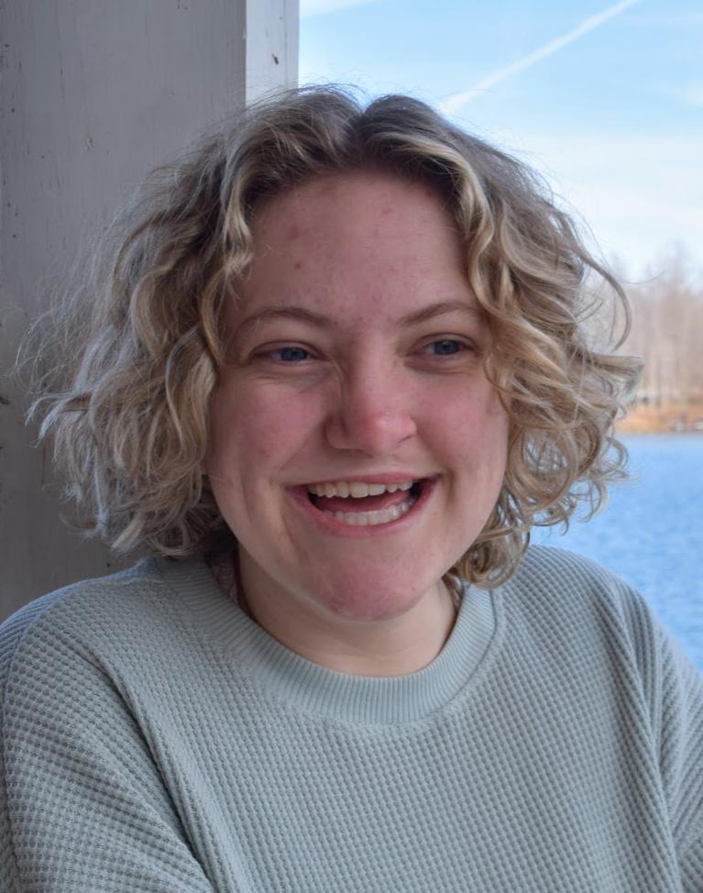
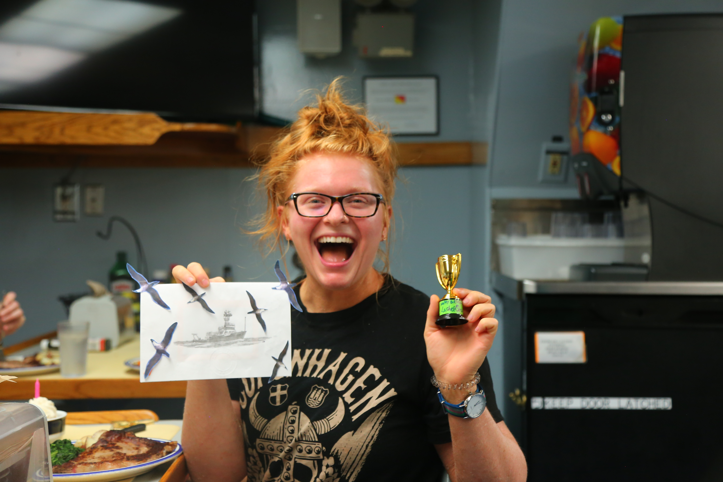

Zooplankton Elemental Composition in the Amazon River Plume Region
G.H. Davenport¹, E.A. Strope², J.P. Montoya²
¹ James Madison University, Harrisonburg, VA 22801 USA
² School of Biology, Georgia Institute of Technology, Atlanta, GA 30332 USA
OCE-1737078
OCE-1851723
I. Summary
The Amazon River generates an extensive surface plume, the Amazon River Plume (ARP), that reaches hundreds of kilometers into the Western Tropical North Atlantic. Within the ARP, distinct phytoplankton habitats are generated by the interplay of various physical and chemical factors. The impact of these factors on higher trophic levels has not been studied. We measured the elemental composition of five size fractions of zooplankton, a critical link between phytoplankton and upper trophic levels in the ocean. Specifically, we measured the nitrogen, carbon and phosphorus content, in addition to the isotopic composition (δ¹⁵N and δ¹³C) of zooplankton collected during cruise EN614 in spring 2018. We found statistically significant differences in zooplankton phosphorus content, C:P and N:P ratios between planktonic habitats and day vs. night samples. Further, we integrated these results with stable isotope data to assess the degree and nature of nutrient limitation among each habitat.
IV. Methods
V. Results
C:P and N:P lower in migratory (night) zooplankton
C:N and P content decreases, as plume influence decreases (YPC to OSW)
No difference in elemental ratios between zooplankton size fractions
δ13C and δ15N peak in WPM
Total Dissolved
P Content
C and N Content
δ13C and δ15N
VI. Conclusions
Non-migratory zooplankton are more limited by phosphorus than migratory zooplankton. This is contrary to the typical movement of phosphorus in the biological pump. Phosphorus is typically transported by migratory zooplankton and then excreted in the upper water column.
Nutrients, specifically phosphorus, from the Amazon River dissipate as plume influence decreases. The zooplankton sampled from the YPC habitat displayed the highest phosphorus content by mass fraction.
The YPC habitat is the most nitrogen stressed. This habitat lacks diazotrophs to supply zooplankton with fixed nitrogen.
Zooplankton sampled from the WPM are possibly ingesting larger cells with higher δ¹³C values.
The WPM contains diazotrophs that produce low δ¹⁵N values. Surprisingly, we found this habitat had the highest δ¹⁵N values, possibly due to the lag between ingestion and incorporation of nitrogen in zooplankton tissues.
Zooplankton collected on cruise EN614 in May-June 2018 with MOCNESS and Meter Net tows
Continuous-flow Isotope Ratio
Mass Spectrometry (CF-IRMS)
II. Who Cares?
The ARP creates distinct phytoplankton habitats based on biogeochemical factors like surface salinity, temperature and nutrient distribution. The link between habitats and higher trophic levels, like zooplankton, is unknown.​
Zooplankton are primary and secondary consumers and connect ocean trophic levels and influence nutrient cycling in the ocean.​
In plankton, major nutrients typically follow the Redfield Ratio: (C:N:P) 106:16:1. Comparing zooplankton C:N:P ratios can help determine limiting nutrients. ​
Isotopic ratios (δ15N and δ13C) help track an organism’s trophic position and food source.​
Figure 2: (below) Three boxplots displaying the effect of collection time on (a) C:P ratio (p=0.005), (b) N:P (p=0.002) and (c) C:N (p=0.089).
a
ac
bc
bc
(a)
(a)
C:P
a
a
a
b
(b)
Day Night
Citations
Haupt, F., Stockenreiter, M., Reichwaldt, E. S., Baumgartner, M., Lampert, W., Boersma, M., & Stibor, H. (2010). Upward phosphorus transport by Daphnia diel vertical migration. Limnology and Oceanography, 55(2), 529–534.
LaRoche, J., & Breitbarth, E. (2005). Importance of the diazotrophs as a source of new nitrogen in the ocean. Journal of Sea Research, 53(1–2), 67–91.
Montoya, J. P. (2008). Nitrogen Stable Isotopes in Marine Environments. In Nitrogen in the Marine Environment (pp. 1277–1302). Elsevier.
Pham et al. (in prep)
Weber, S. C., Carpenter, E. J., Coles, V. J., Yager, P. L., Goes, J., & Montoya, J. P. (2017). Amazon River influence on nitrogen fixation and export production in the western tropical North Atlantic. Limnology and Oceanography, 62(2), 618–631.
Weber, S. C., Subramaniam, A., Montoya, J. P., Doan-Nhu, H., Nguyen-Ngoc, L., Dippner, J. W., & Voss, M. (2019). Habitat Delineation in Highly Variable Marine Environments. Frontiers in Marine Science, 6, 112.
III. Study Site
(b)
a
b
bc
ac
(a)
(b)
N:P
δ¹³C(‰)
(c)
Day Night
a
ab
ac
d
(c)
δ¹⁵N(‰)
(d)
Acknowledgements
Thank you to Dr. Joseph Montoya and Erica Strope for mentorship in your lab and thank you to NSF and Georgia Tech for funding my REU experience.
C:N
Figure 1: Amazon river plume (a) EN614 cruise track and phytoplankton habitats and (b) satellite image. Red represents the ‘young plume core’, yellow ‘western plume margin’, purple ‘outer plume margin’ and blue ‘oceanic water’.
Day Night
Figure 3: (above) Four boxplots of (a) P content (p=0.005) (b) C:N (p=0.032) (c) δ¹³C (p<0.005) and (d) δ¹⁵N (p<0.005) separated by habitat type.
Grace Davenport
Erica Strope
Joseph Montoya
Student
Department of Biology
James Madison
Research Tech
School of Biological
Sciences, Georgia Tech
Professor
School of Biological
Sciences. Georgia Tech

